Slide 1
Bank Account System
+++++++++++++++++++++++++++++++++++++++++
+ Team Member Table +
+++++++++++++++++++++++++++++++++++++++++
+NAME: +WORK: +
+++++++++++++++++++++++++++++++++++++++++
+Assass(leader): +GUI frame4 +
+Yakira: +half the class +
+Vicky: +GUI frame1 +
+Luis: +GUI frame2 +
+Eda: +GUI frame3 +
+Clark: +half the class +
+++++++++++++++++++++++++++++++++++++++++
Team members:
Assess Yakira Eda
Clark Vicky Luis
Python OOP Assignment 4
2019 / 12 / 05

Slide 2
The Functional Requirement
Everyone’s Work Part

Slide 3
The Functional Requirement
Notes:
功能需求

Slide 4
To realize the systematization, standardization, automation and intelligence of bank account management. The specific goals of the system are as follows:
(1) Keyboard operation, quick response.
(2) For the data entered by users, the system will conduct strict data testing to avoid human errors.
(3) Bank withdrawals, deposits, inquiries and other functions.
(4) Stable and reliable system operation.
Notes:
实现银行账户管理的系统化、规范化、自动化、智能化。该系统的具体目标如下:
(1)键盘操作，反应快。
(2)对于用户输入的数据，系统会进行严格的数据测试，避免人为错误。
(3)银行取款、存款、查询等功能。
(4)系统运行稳定可靠。

Slide 5
Work part

Slide 6
Introduce
Name: Yakira
ID: 201810701580034
Class: net182
Group: 3
Work: Part of bank class
(from 1 to 73 lines)

Slide 7
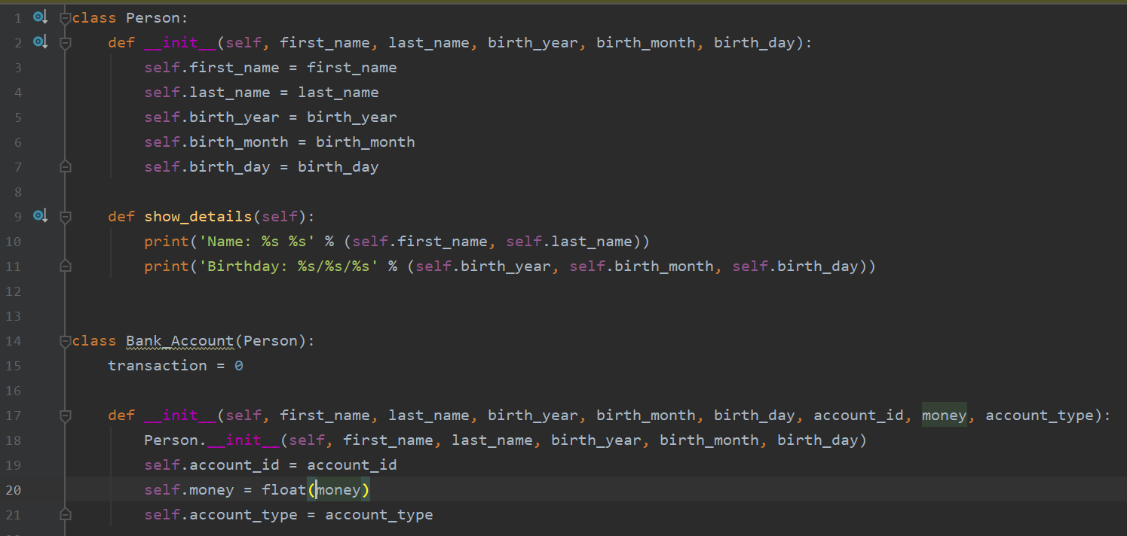
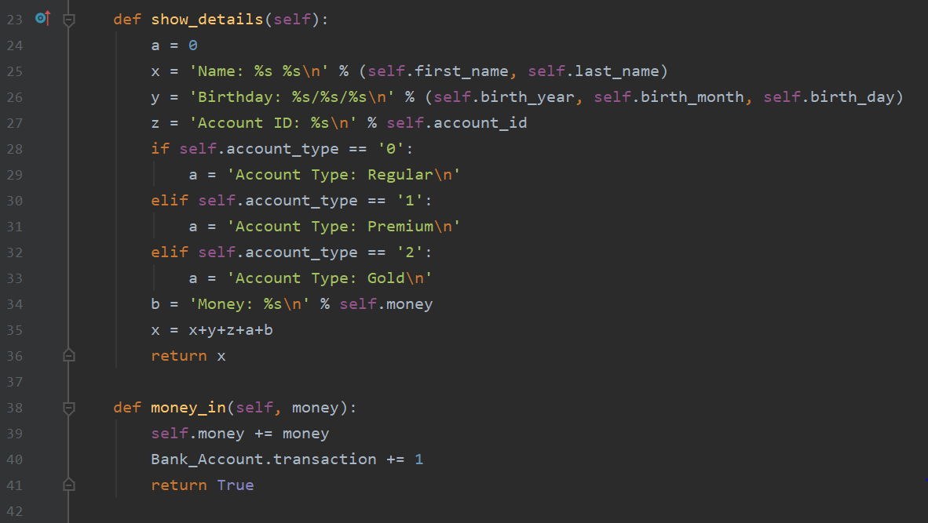
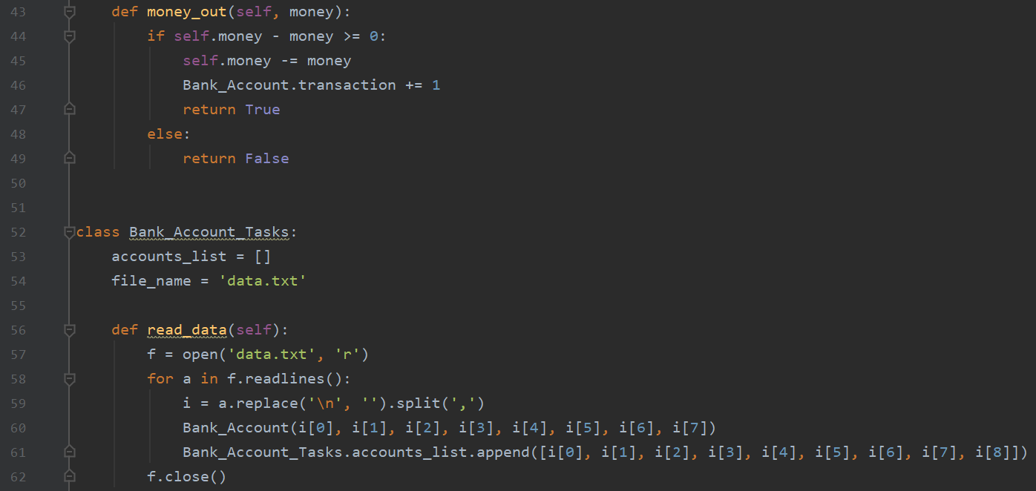
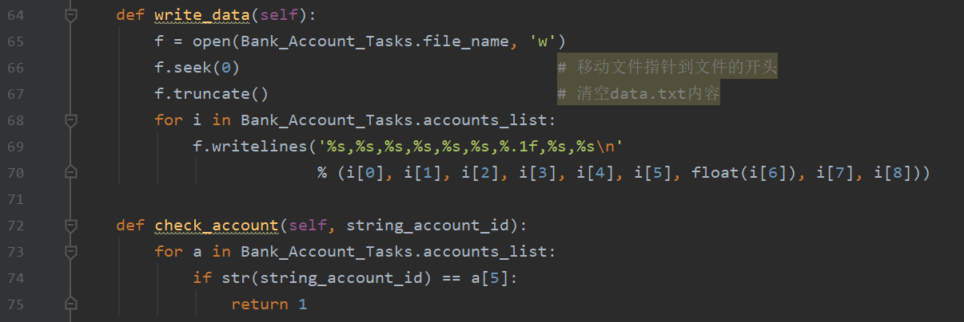
Yakira’s Part

Slide 8


The work of Yakira
‘ Person ’ is the super class, base class or parent class.
‘ Bank_Account ’ is a subclass or child class
public variable
Notes:
objects Person are made using classes. An object Person is an instance of a class.对象是使用类创建的。对象是类的实例。
Class methods are a little different from ordinary functions. They must have an extra word that has to be added to the beginning of the parameter list. This word is self. 类方法与普通函数稍有不同。它们必须在参数列表的开头添加一个额外的单词。这个词就是自我
Inheritance (function) means you can make one class, then make another class that uses the same fields and methods of the first class.
The __init__ method There are many method names which are special in Python classes. The __init__ method is run as soon as an object of a class is instantiated (made). There are 2 underscores _ at the start and 2 underscores at the end of the word init. The purpose of the __init__ method is to give values to the object variables.
Public: the variables and methods can be used anywhere.

Slide 9
The work of Yakira
Here are some details about the customers
It makes it easier for Banks to check customer information
Customers deposit money in the bank
Notes:
Same name : local variable
记录：record
Transaction: 交易，事务
return的作用就是讲函数执行结果返回给调用程序： The purpose of return is to return the result of the function execution to the caller return true； 返回正确的处理结果: Returns the correct processing result.
Determine type: 判断类型

Slide 10
The work of Yakira
Customers withdraw money from the bank
To read data.txt , and store the data
in the Bank_account
Notes:
return false；返回错误的处理结果；终止处理: Return error processing result ; Termination of processing
内容：content

Slide 11
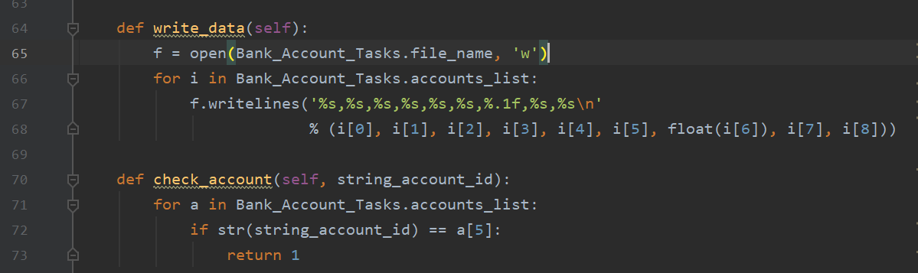
The work of Yakira
Write data that does not exist in the text
and check account id
Notes:
In interactive mode, the result of the return is automatically printed, but when run alone as a script, the print function is required to display it.
在交互模式下，return的结果会自动打印出来，而作为脚本单独运行时则需要print函数才能显示。
If the function does not return, return a None object by default.
如果函数没有返回，则默认返回一个None对象。

Slide 12
introduce
name: Clark
class: net182
ID：
201810701580047
group: 3
work: the half class method
(from 80 to 161 lines)

Slide 13
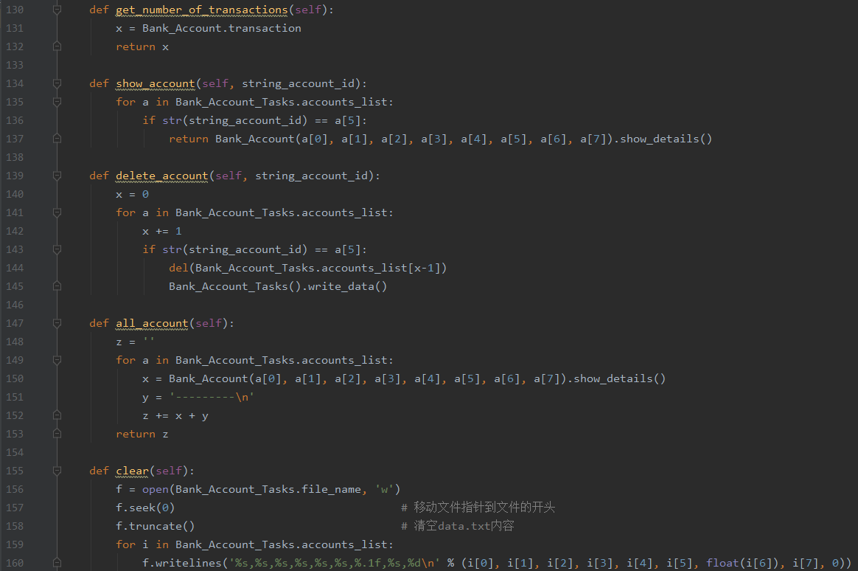
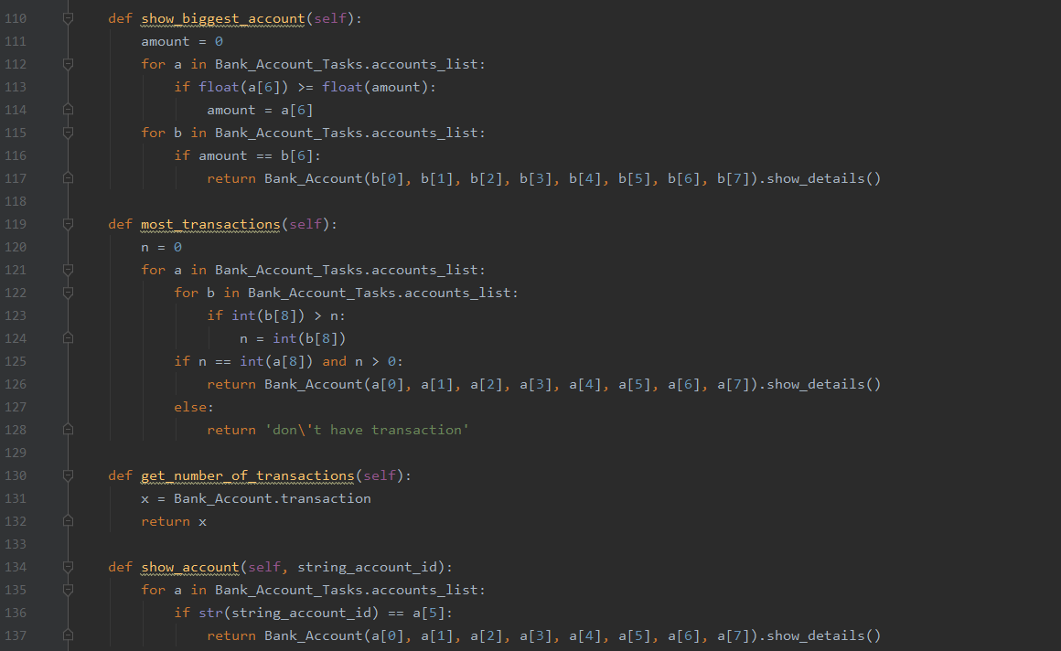
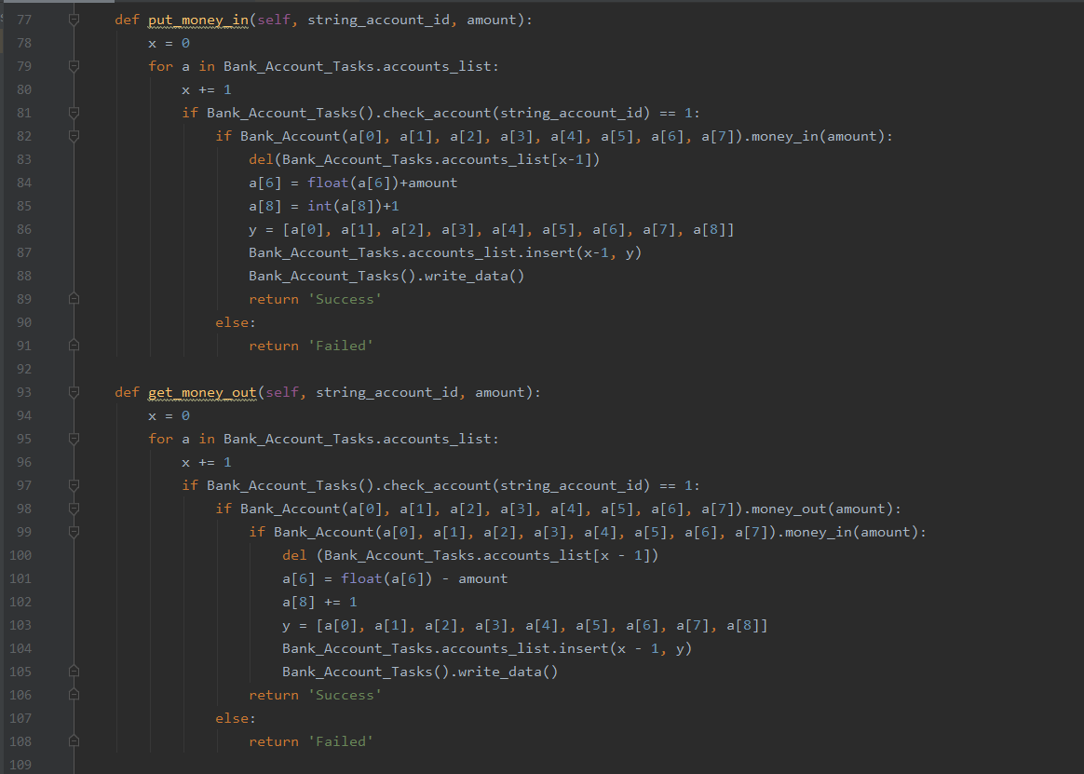
This is my part

Slide 14
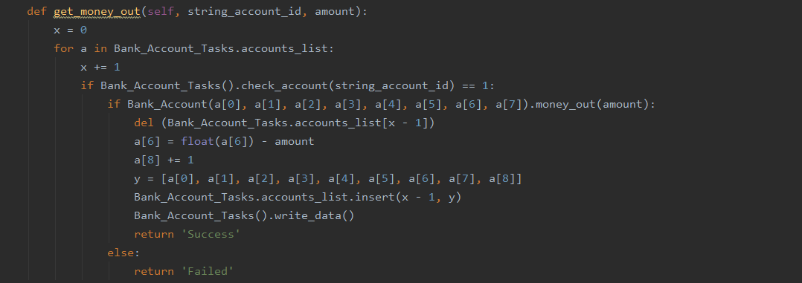
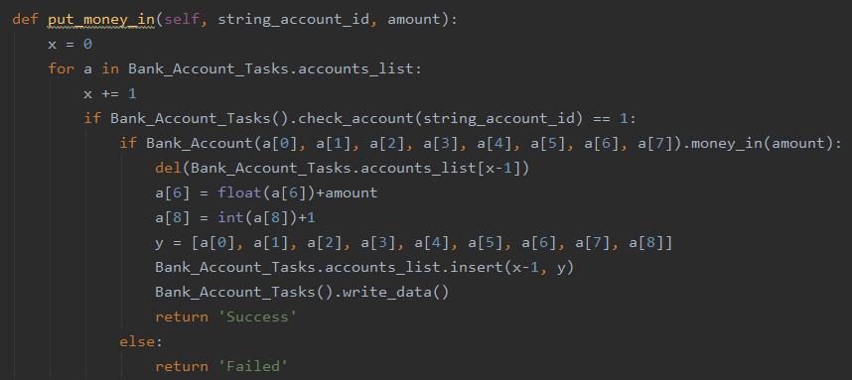
put and get money
this part's function is change the amount of money in data.txt

Slide 15
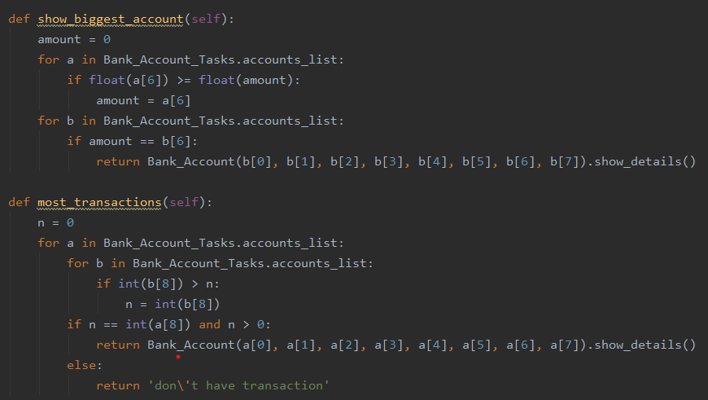
show biggest information
this part I use the same way to finish it ：
1.for loop check biggest information
2.output the data

Slide 16
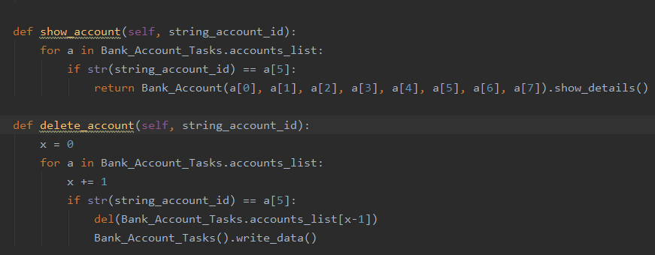
parametric method
all of this part's method. They need user enter parameter to carry out the method

Slide 17
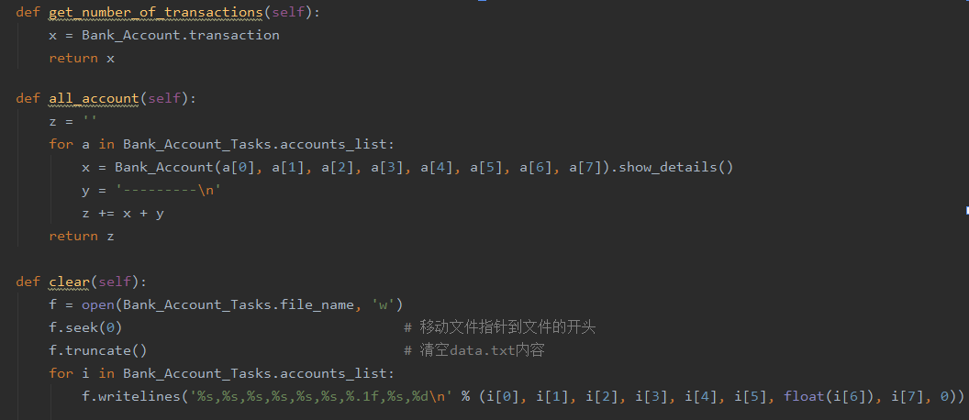
most simple method
this part I just need use global parameter, read_data(),wirte_data() part of assass work

Slide 18
Introduce
Name:Vicky
ID: 201810701580032
Class: Net182
Group: 3
Work: Frame1
(from 11 to 73 lines
from 126 to 141 lines)

Slide 19
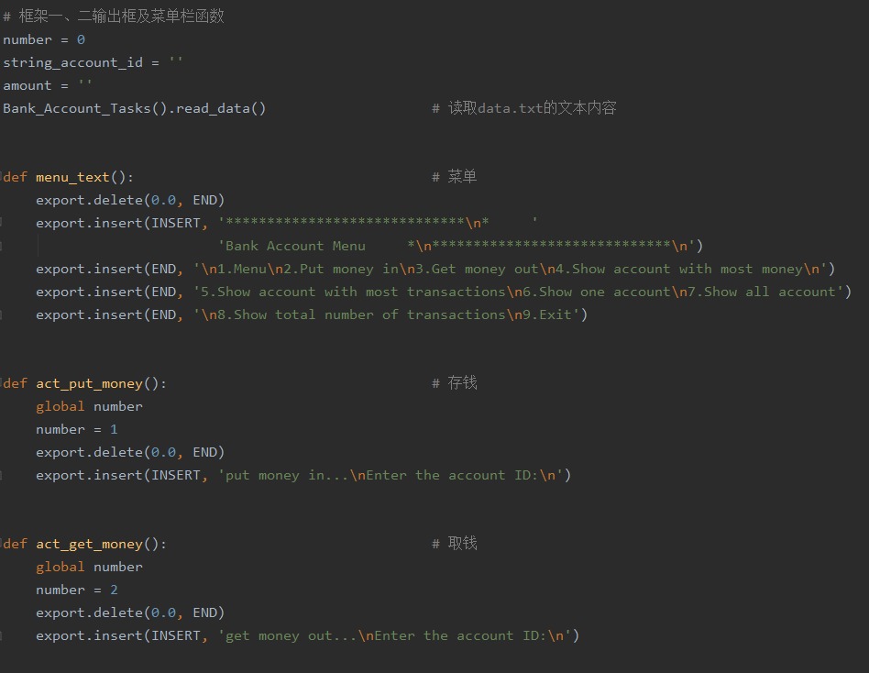
The global variable

Slide 20
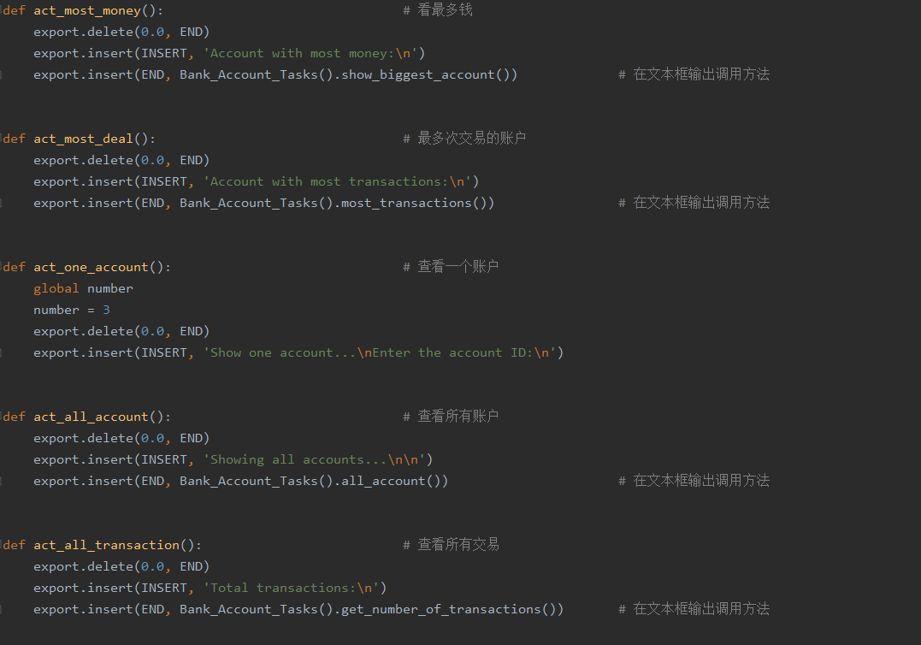
Output the call method in the text box

Slide 21
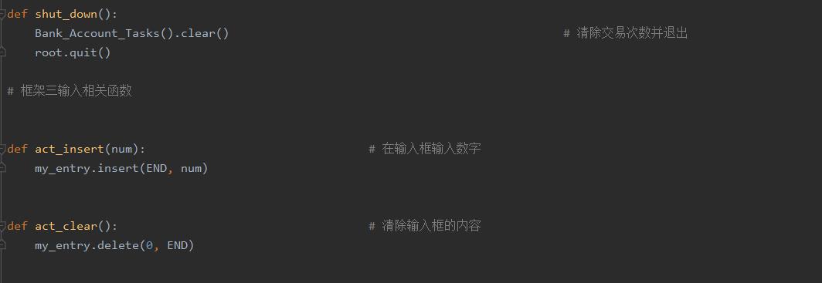
Clear trades and exit

Slide 22
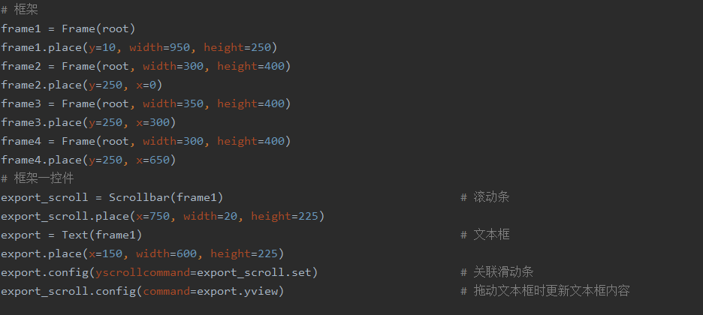
Vicky’s part
Association slider
Update the text box contents as you drag it

Slide 23
Introduce
Name: Luis
ID: 201810701580033
Class: net182
Group: 3
Work: Frame2
(from 11 to 73 lines
from 145 to 158 lines)

Slide 24
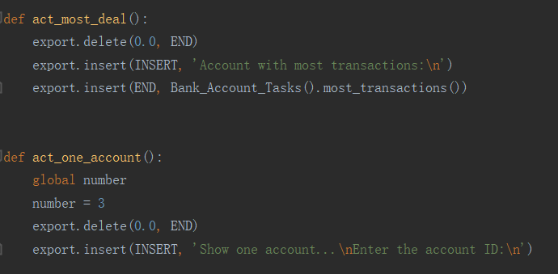
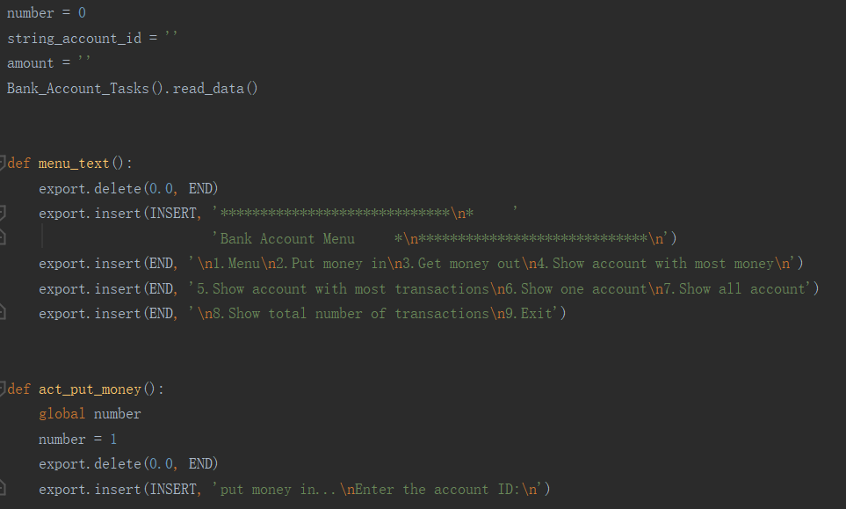
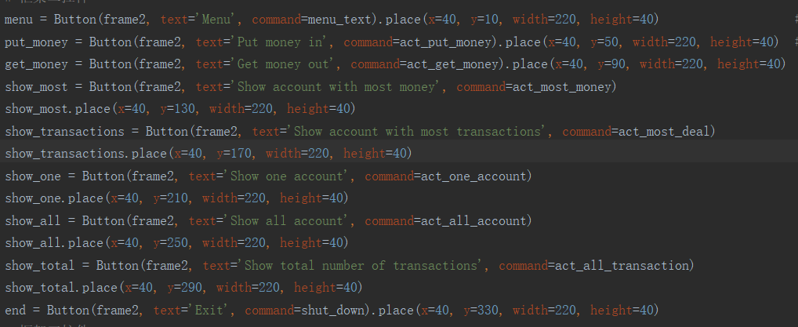
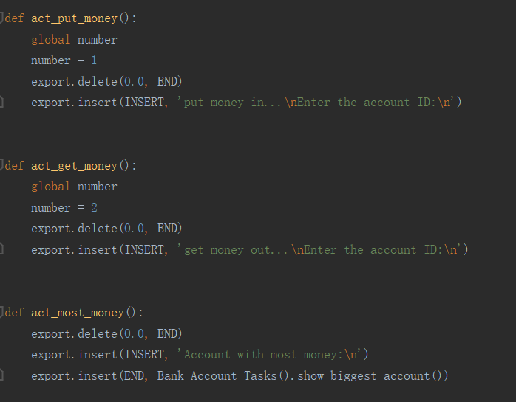
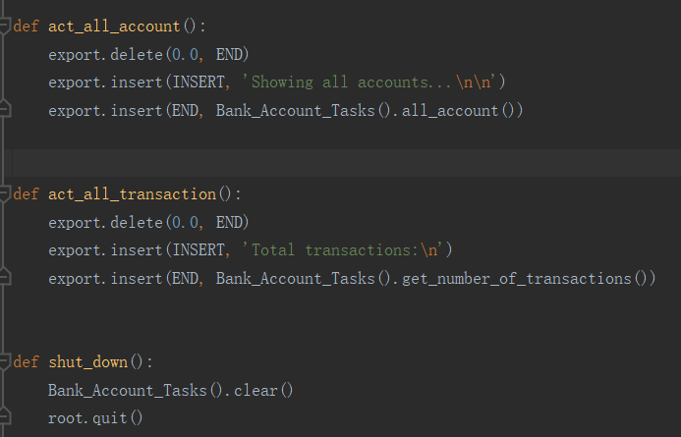
Luis’s Part

Slide 25
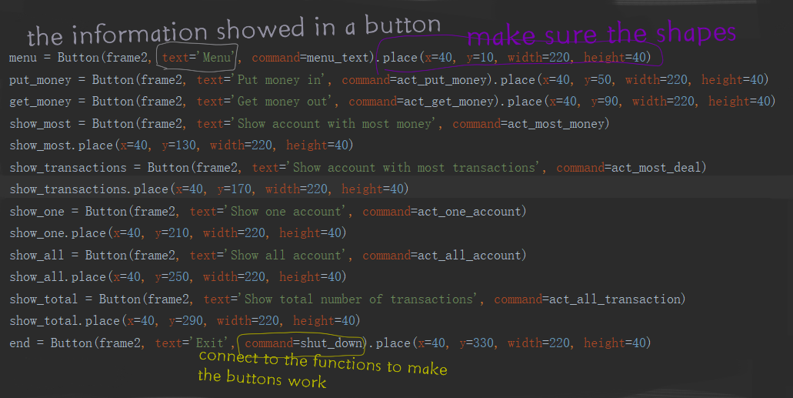
The work of Luis
Notes:
objects Person are made using classes. An object Person is an instance of a class.对象是使用类创建的。对象是类的实例。
Class methods are a little different from ordinary functions. They must have an extra word that has to be added to the beginning of the parameter list. This word is self. 类方法与普通函数稍有不同。它们必须在参数列表的开头添加一个额外的单词。这个词就是自我
Inheritance (function) means you can make one class, then make another class that uses the same fields and methods of the first class.
The __init__ method There are many method names which are special in Python classes. The __init__ method is run as soon as an object of a class is instantiated (made). There are 2 underscores _ at the start and 2 underscores at the end of the word init. The purpose of the __init__ method is to give values to the object variables.
Public: the variables and methods can be used anywhere.

Slide 26
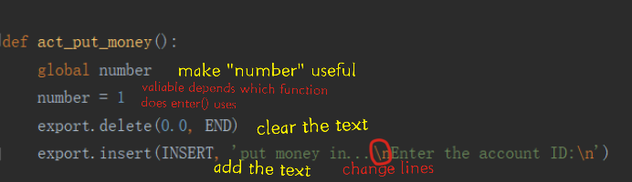
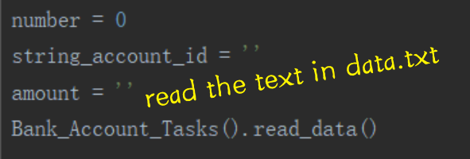
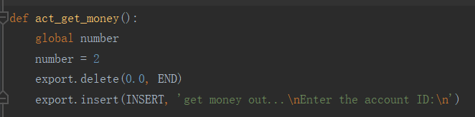
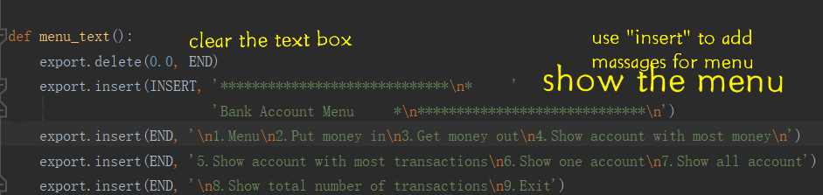
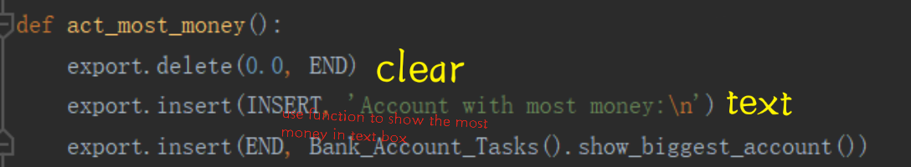
The work of Luis
Notes:
objects Person are made using classes. An object Person is an instance of a class.对象是使用类创建的。对象是类的实例。
Class methods are a little different from ordinary functions. They must have an extra word that has to be added to the beginning of the parameter list. This word is self. 类方法与普通函数稍有不同。它们必须在参数列表的开头添加一个额外的单词。这个词就是自我
Inheritance (function) means you can make one class, then make another class that uses the same fields and methods of the first class.
The __init__ method There are many method names which are special in Python classes. The __init__ method is run as soon as an object of a class is instantiated (made). There are 2 underscores _ at the start and 2 underscores at the end of the word init. The purpose of the __init__ method is to give values to the object variables.
Public: the variables and methods can be used anywhere.

Slide 27
The work of Luis
Notes:
objects Person are made using classes. An object Person is an instance of a class.对象是使用类创建的。对象是类的实例。
Class methods are a little different from ordinary functions. They must have an extra word that has to be added to the beginning of the parameter list. This word is self. 类方法与普通函数稍有不同。它们必须在参数列表的开头添加一个额外的单词。这个词就是自我
Inheritance (function) means you can make one class, then make another class that uses the same fields and methods of the first class.
The __init__ method There are many method names which are special in Python classes. The __init__ method is run as soon as an object of a class is instantiated (made). There are 2 underscores _ at the start and 2 underscores at the end of the word init. The purpose of the __init__ method is to give values to the object variables.
Public: the variables and methods can be used anywhere.

Slide 28
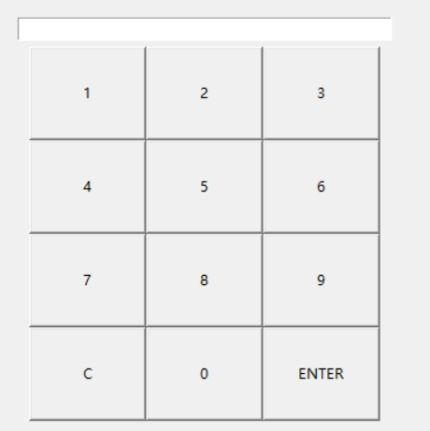
The part of Eda
Introduce
Name: Eda
ID: 201810701580031
Class: net182
Group: 3
Work: Frame3

Slide 29
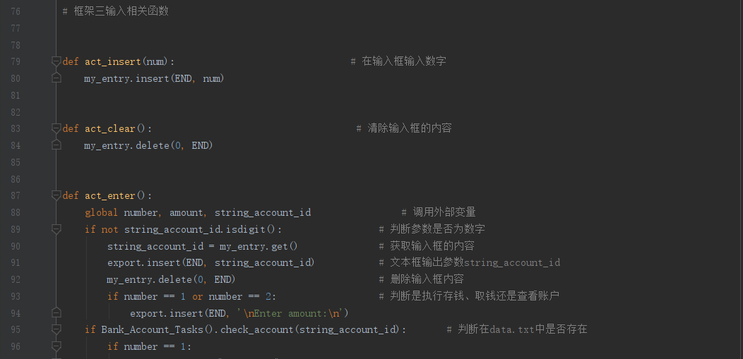
Eda’s part

Slide 30
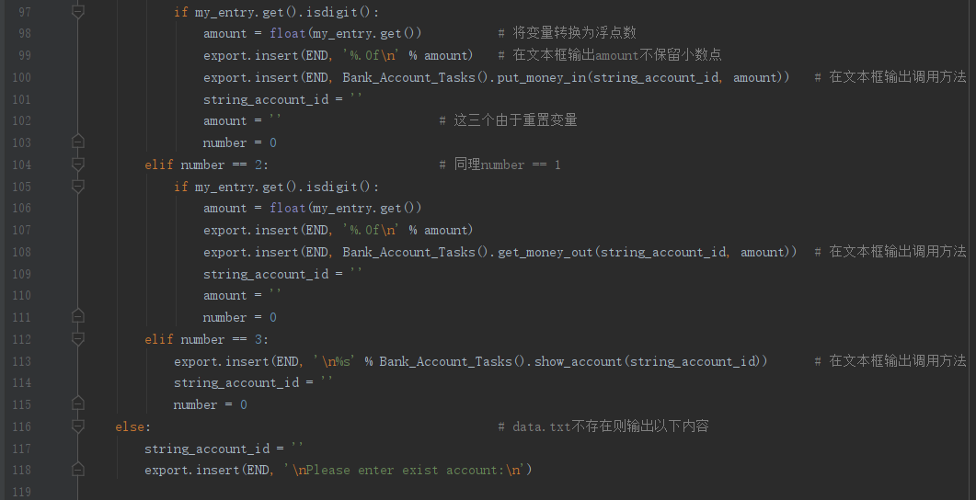
Eda’s part

Slide 31
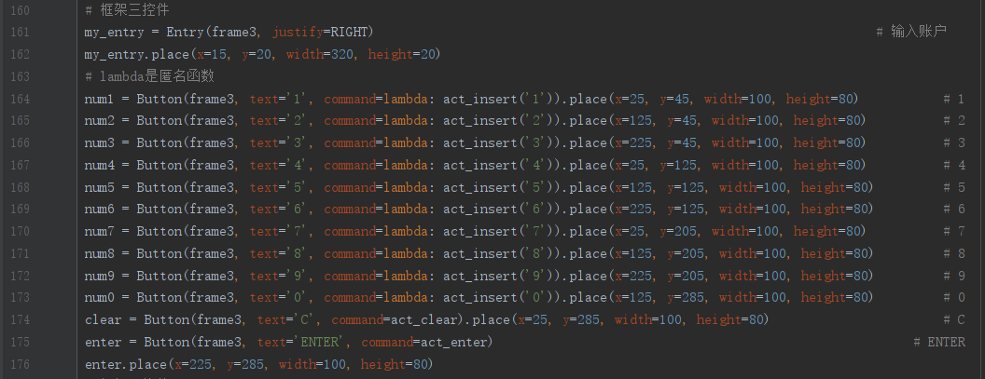
Eda’s part

Slide 32
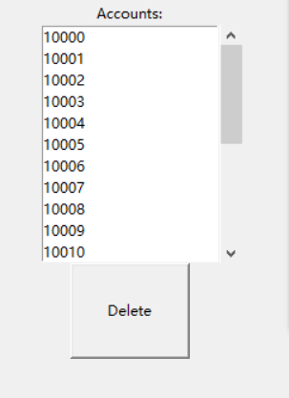
Introduce
Name: Assass
ID: 201810701580040
Class: net182
Group: 3
Work: Frame4

Slide 33
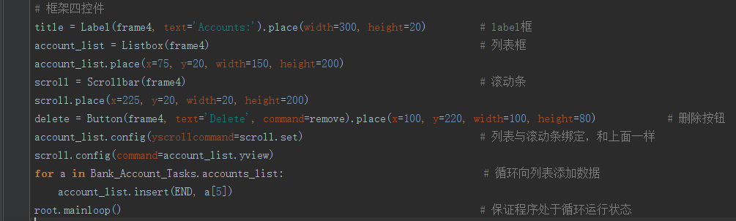
The work of Assass
appends the value in to the listbox, this is the function of the for loop

Slide 34
The work of Assass
this part's function is conect listbox with scrollbox

Slide 35
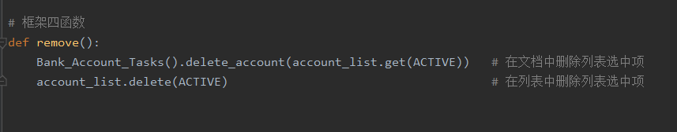
The work of Assass
this function can remove the selected data from data.txt and listbox

Slide 36
thank you

